Slide 1
Task 191553: talkPHR Data in Health App (Apple OAuth)
Document Type:Draft
Documented by: Shahzeb Khan(System Analyst)

Slide 2
Storyboard Review Summary
Below is the review summary of document.
Review Summary
Sr. # | Reviewed By | Designation | Date
1 | Asif Ali | Senior System Analyst | 08/07/2019
2
3
4

Slide 3
Current Status
[Currently this change is not available…]

Slide 4
Industry Standard
The best practice is to implement OAuth recommendation for PHR health data.

Slide 5
PROPOSED CHANGE

Slide 6
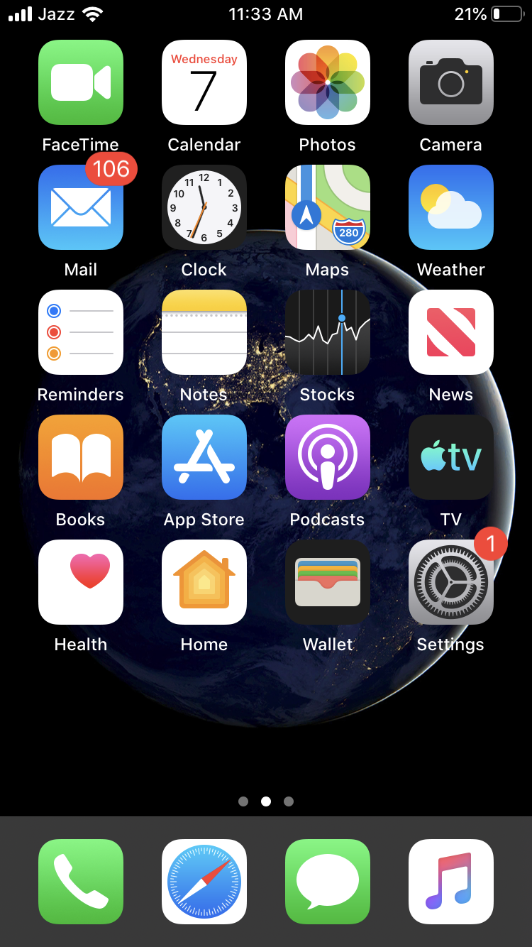
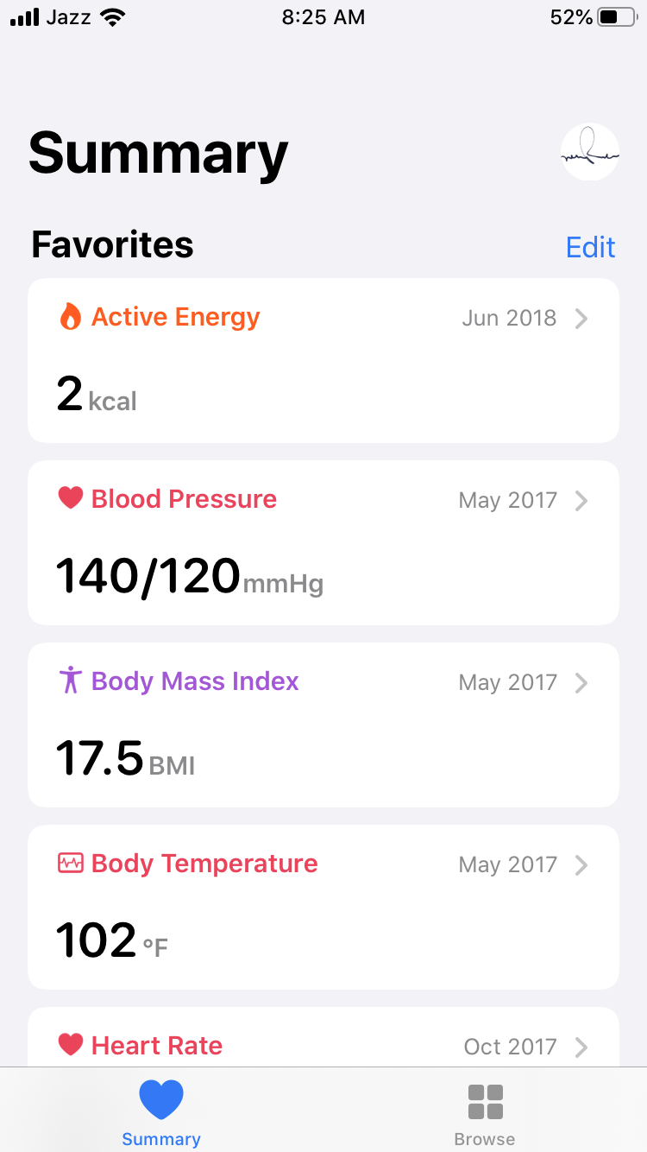
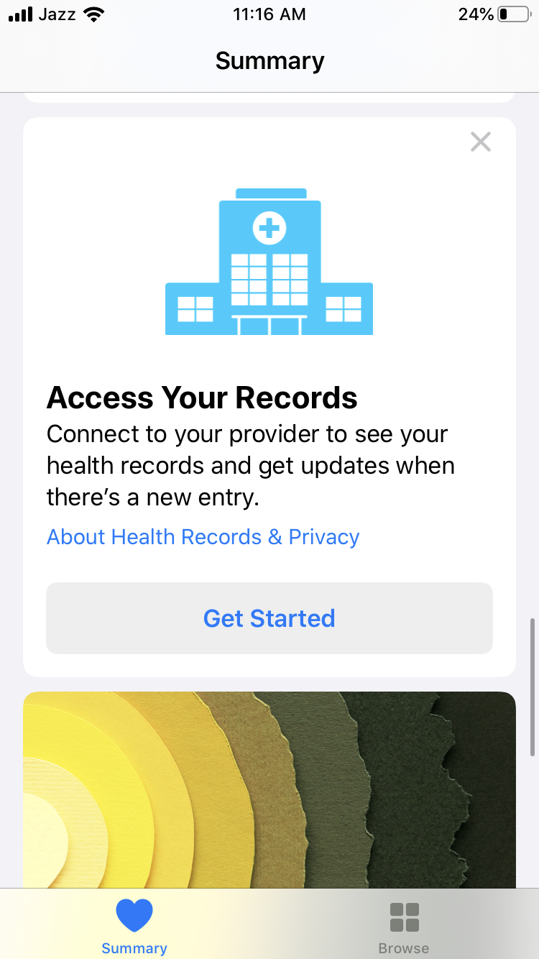
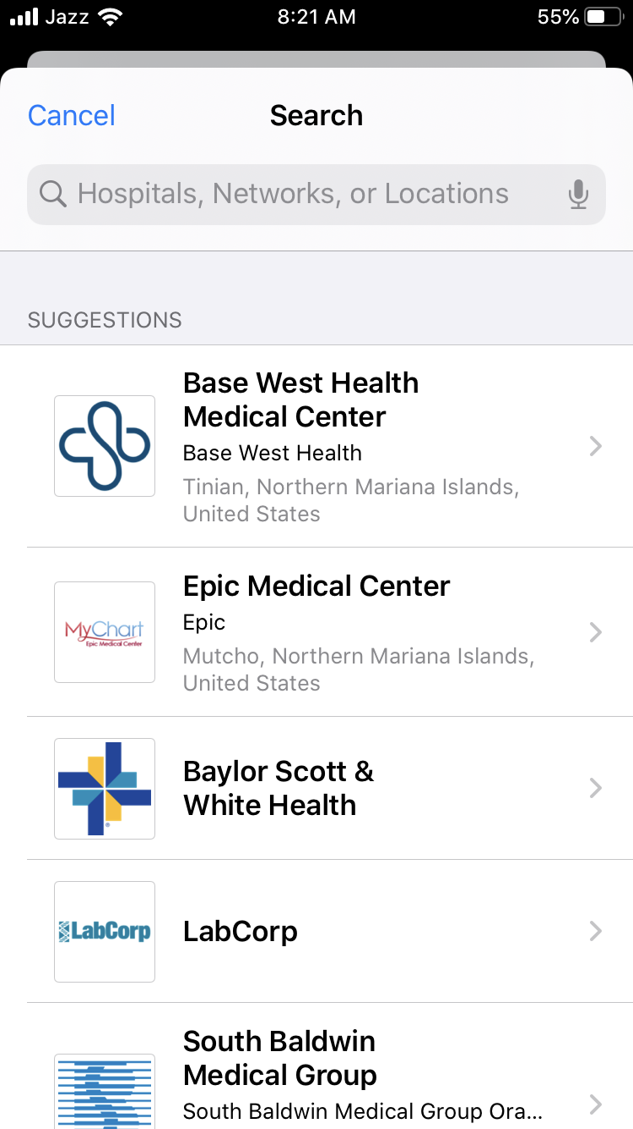

Health App Flow for MTBC PHR Patients
Health App will follow the flow as:
By tapping on Health app, user redirect to Summary Screen.
By tapping Get started on Summary Screen of Health, new screen will be open where number of OAuth screen will appear.
OAuth screen is basically a web browser that allow PHR user to show their records on Apple Health App.

Slide 7
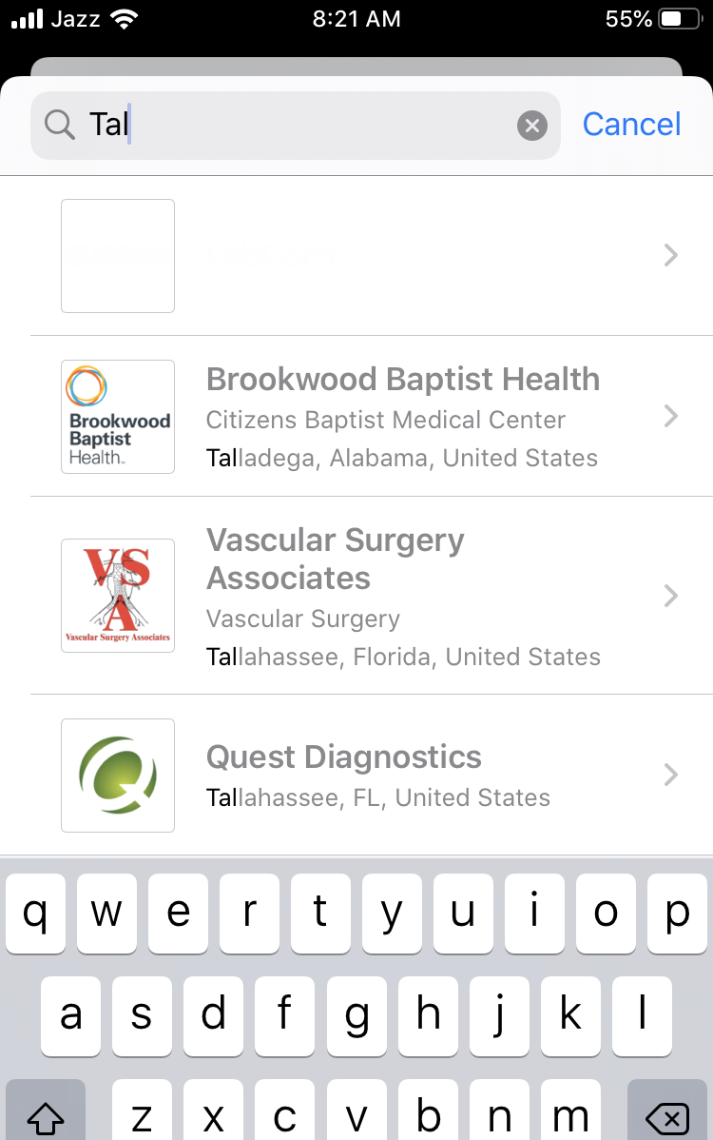
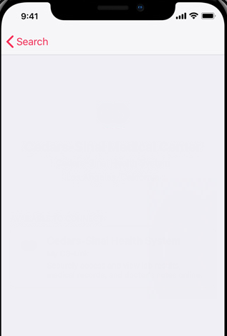
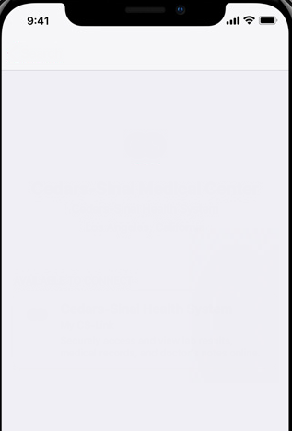



Health App Flow for MTBC PHR Patients
By searching talkPHR, talkPHR OAuth screen will display.
By tapping on talkPHR, new screen will appear to connect with talkPHR.
By tapping on Connect to Account, OAuth screen will appear.
Here, user need to add credential for getting information of Health data.
Cancel
talkPHR
PHR
MTBC Patient Health System
7 Clyde Road, Somerset, NJ 08873
PHR
PHR
MTBC Patient Health System
7 Clyde Road, Somerset, NJ 08873
Enter Email or Cell No *
Password *
AVAILABLE TO CONNECT
MTBC Patient Health System
Securely access and view Allergies, Clinical Vitals, Conditions, Immunizations, Lab Results, Medications and Procedures online.
Sign In
Connect to Account
Create Account
Forgot Password

Slide 8
Sign In→ Validations
‘Email/Cell no’:
Email format example@example.com with max length 50 characters should be allowed in email field.
Cell phone format will be (XXXX) XXX-XXX and only 10 digits numeric characters are allowed, special character will be auto filed.
If user don’t enter Email/cell phone, then error message will display “Enter Email or Cell No”.
If user does not input valid email/cell phone “Invalid Email or Cell No” message should be displayed.
If user enter an email and not following format then “Enter valid Email” message should be displayed.
If user enter cell phone and not following format then “Enter valid Cell No” message should be displayed.
If user enter an email/cell number with password that not exist in talkPHR database then “Invalid Email or Cell No or Password” should be displayed.
If user does not input a valid password : “Invalid Email or Cell No or Password” should be displayed
‘Password’
If user does not input password : “Enter password” should be displayed.
If user does not input a valid password : “Enter a valid password” should be displayed.
‘Password Instructions’
Your password must be 8 to 32 characters long.
A number or symbol
A lowercase letter.
An UPPERCASE letter.

Slide 9
Forgot Password
When user click on Forgot Password a popup will open.
When user enters Cell No or Email, an email/message with Pin code will sent on given Email/Cell No.
User enter that pin code on Account verification Page and can set new password.
Pin Code sent on Email ID or Cell # will be expired after a 24 hours interval.
Reset Password Instructions
Your password must be 8 to 32 characters long.
Containing at least one number.
An optional special character !@#$%^&*()
Password should be alphanumeric.

Slide 10

Forgot Password
When user tap on Submit after entering email or cell no, if this email/cell no exists in PHR then an email/message send to on entered Email/Cell No.
Email/Cell no will contain a Pin code.
All fields are required on enter-password screen.
Pin will consist the combination of 5 characters (numbers) and PIN code field will only allow 5 characters.
Pin Code sent on Email ID or Cell # will be expired after a 24 hours interval.
If user enter less then 5 characters, error message will be “The length for this field is 5 characters.”
When user enter new password, password validation will apply as mentioned in slide 9 password validation.
Cancel
talkPHR/login
Cancel
talkPHR/reset-password
Cancel
talkPHR/enter-password
PHR
Password Reset
PHR
PHR
A PIN code has been sent to the email address
on record: sha***********@mtbc.com Please
check your email and enter the code below.
Password Reset
Enter Email or Cell No *
Password *
PIN Code *
Enter the email/cell no associated with your
MTBC PHR account
Make sure to check your spam folder if you have not received
your code yet
Enter Email or Cell No *
Password *
Sign In
Submit
Confirm Password *
Create Account
Cancel
Continue to Sign In
Forgot Password
Cancel

Slide 11
Create an Account
Validations:
‘Date of Birth (DOB)’:
Mandatory: If user does not input a value then error message “Please enter your DOB” will appear.
DOB format will be MM/DD/YYYY
If user not follow DOB format then error “Please enter valid DOB format” will return
‘Enter Email or Cell No’:
All checks that define for Email/Cell No on slide 8 will apply against “Enter Email or Cell No”.
Pin Code sent on Email ID or Cell # will be expired after a 24 hours interval.
User can create account through OAuth screen by tapping on Create Account Link.
User will add all information on registration screen.
All fields are mandatory for registering on PHR.
When user tap on register after entering data, entered email/ Cell No will validate
through talkEHR and if found then a PIN will send to user.
Pre-condition: User must be registered on talkEHR.
User enter Pin and set Password on same screen with Password validations slide 8.
If user not enter Pin error message will be “Please enter PIN”
Cancel
talkPHR
Cancel
talkPHR/Signup
Cancel
talkPHR/enter-password
PHR
Password Reset
PHR
PHR
A PIN code has been sent to the email address
on record: sha***********@mtbc.com Please
check your email and enter the code below.
Create an Account
Enter Email or Cell No *
Password *
Enter Email or Cell No *
PIN Code *
Make sure to check your spam folder if you have not received
your code yet
DOB *
Password *
Sign In
I have read, understand and agree to the MTBC
PHR Terms of Use and Privacy Policy.
Confirm Password *
Create Account
Register
Continue to Sign In
Forgot Password
Cancel
Cancel

Slide 12
Database Details
Need to add Table PHR_Profile_Tokens having Columns:
Column Name | Type
TokenId | bigint
UserId | bigint
AccessToken | nvarchar
IssuedOn | datetime
ExpiresOn | datetime
RefreshToken | nvarchar
IssuedOn | datetime
ExpiresOn | datetime
Profile | varchar
AuthorizationCode | varchar
Clinet_id | nvarchar
Client_secret | nvarchar
By clicking on Sign In, when client get access through user credentials and get Authorize Grant Access, Authorization server sends an access token to client for communicating with Resource server. After getting access token client can communicate with resource server for getting Protected Resources. This access token will store in table PHR_PROFILE_TOKENS.
Further detail of Access token and Refresh Token discussed with detail in OAuth Flow

Slide 13
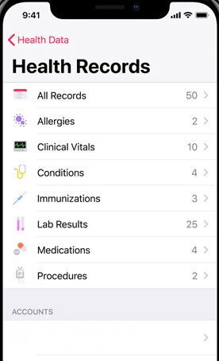
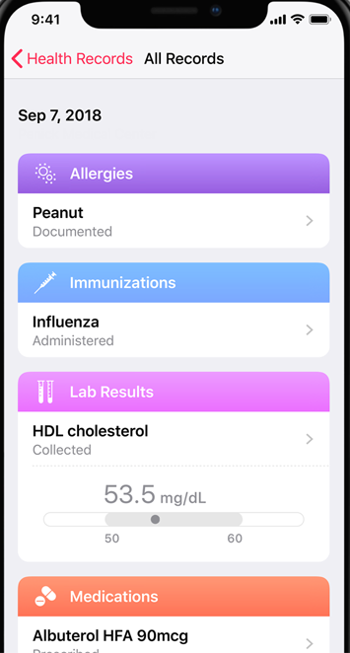



Health App Flow for MTBC PHR Patients
After Sign In, a screen will show to get access of Allergies, Clinical Vitals, Conditions, Immunizations, Lab Results, Medications and Procedures.
User tap on Allow access and Health records retrieve through talkPHR by OAuth Flow 2.0.
Health records will show Allergies, Clinical Vitals, Conditions, Immunizations, Lab Results, Medications and Procedures. This data will be periodically change.
Cancel
talkPHR
MTBC Patient Health System
Connect PHR to
Health App
Allow Health App to access your Allergies, Clinical Vitals, Conditions, Immunizations, Lab Results, Medications and Procedures. Your data will be periodically refreshed.
All records will get from talkPHR after getting access
CHOOSE A PERSON TO CONNECT
Sarah Lane 07.04.1976
Elizabeth Lane 02.21.1968
Allow Access
PHR
MTBC Patient Health System

Slide 14
Database Details
The details of Allergies, Clinical Vitals, Conditions, Immunizations, Lab Results, Medications and Procedures will get from below tables:
AF_TBL_PATIENT_ALLERGY
AF_TBL_PATIENT_IMMUNIZATION
AF_TBL_PATIENT_VITALS
AF_TBL_PATIENT_PRESCRIPTION
AF_TBL_PATIENT_PROCEDURES
PATIENT_ORDER_RESULTS
PATIENT_ORDERS
PATIENT_ORDER_TESTS
AF_TBL_PATIENT_PROBLEM

Slide 15
Concerns
Why we are using MTBC name for OAuth screen? We need to add any Hospital or Clinic name instead of MTBC as per call with Apple.
What are the parameters that are needed for registering MTBC PHR with Apple?
How HL7 team will get request from Client to use Protected Resources (Format)?
Health app uses two interactions, read and search in REST Operation? (What will we are going to use for interaction read or search)

Slide 16
Details
When user want to add another account for same user with same health organization, user must need to remove that account from Summary->Profile->Health records->Select account to remove->Remove Account for using other account.
User can add multiple health organization from Summary->Profile->Health records->Add Account.

Slide 17
Helping Work (Research)

Slide 18
OAuth Process Architecture
Resource server validates the access token, and if valid, serves the request.
Resource Server (PHR Server)
Client requests the protected resource from the resource server and authenticates by presenting the Access Token
Client send Authorization code with redirect URI to Authentication sever for getting Access Token
Client (Apple)
When Authorization code and URI matches, then authorization server response with Access Token
Client Initiate the flow by directing the resource owner to User Agent (Browser).
Authorization server redirects user agent back to the client by using the redirection URI. This URI include
authorization code and local state.
User Agent contains an OAuth screen.
Client includes identifier & Redirection URI
User Agent (Browser)
User Authenticated by entering credentials on OAuth screen
Authorization Server (PHR Authorization Server)
After successful authentication, server will provide Authorization Code
OAuth screen will show to Resource Owner for Authorization Grant
Resource Owner (PHR User)

Slide 19
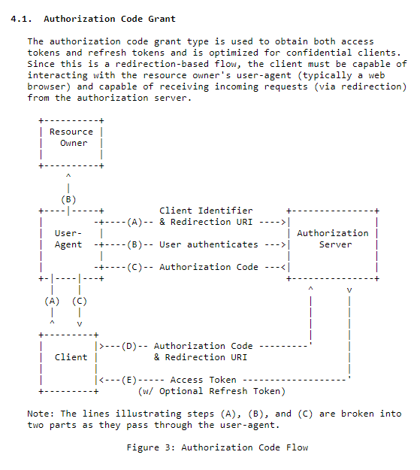
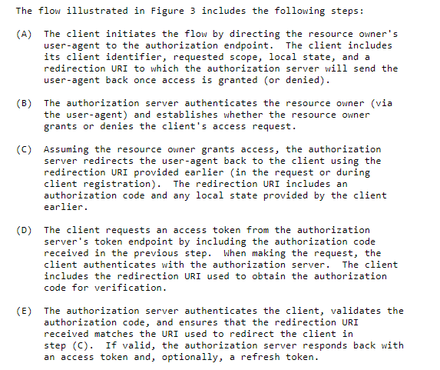

Slide 20
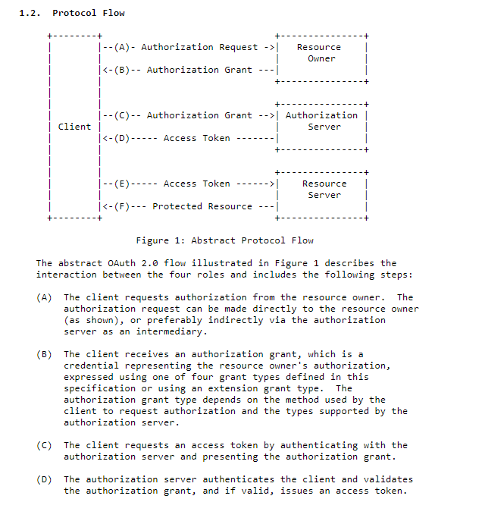
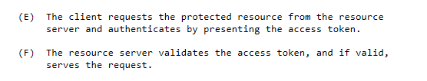

Slide 21
Work Flow of OAuth 2.0
User
Resource Owner
Client
Authorization Request
Authorization Grant
Authorization Server
Authorization Grant
Access Token
Resource Server
Access Token
Protected Resource

Slide 22
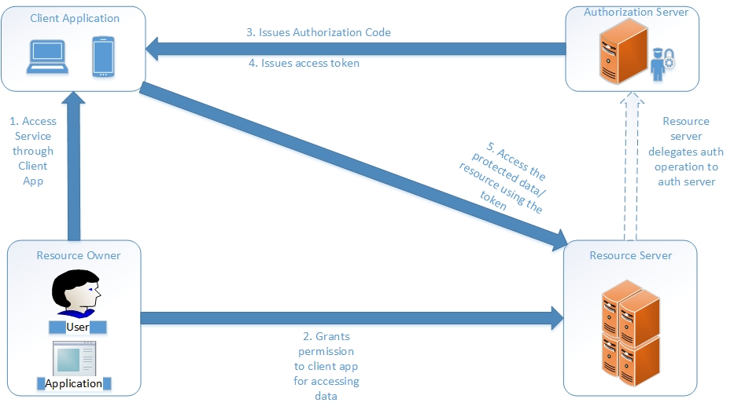
OAuth Workflow Diagram

Slide 23
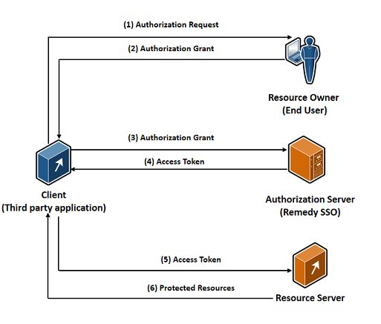
Configuring OAuth 2.0

Slide 24
OAuth Flow 2.0

Slide 25
What is OAuth Flow 2.0?

Slide 26
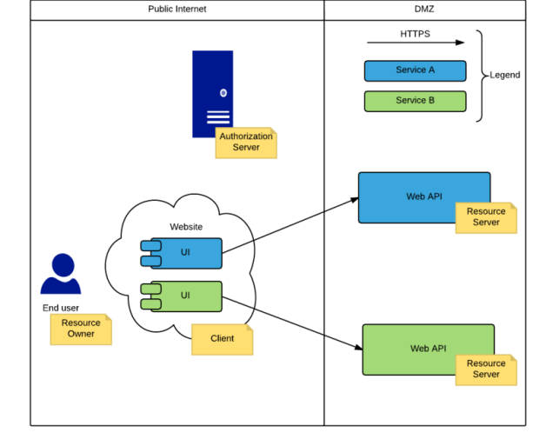
OAuth Flow 2.0
OAuth is an authorization protocol that can be used to enable limited access to private resources for 3rd party apps.
These are the main roles defined by the OAuth protocol:
The resource owner is, as the name says, the owner of the private resource, which means he can grant access to it. Many times the resource owner is the end user.
The resource server hosts the resources. If we’re talking about securing a web APIs – that’s your resource server.
The client is the application that wants to perform actions on the resources on behalf of the owner. A website that is consuming data from web APIs is a good example for a client.
The authorization server grants access to the protected resources to the clients, with the approval of the resource owner.

Slide 27
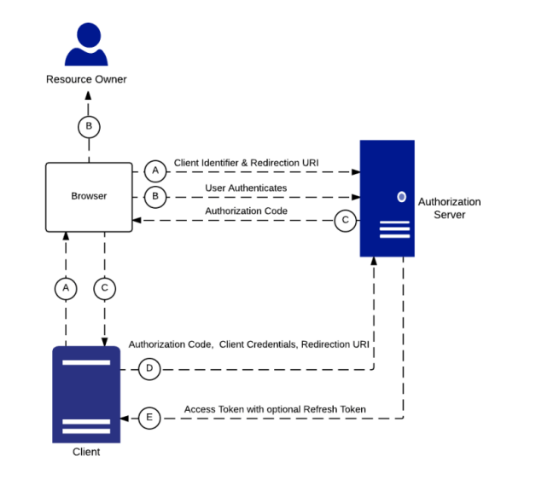
OAuth Flow 2.0
Registration
OAuth requires that clients to register to the Authorization Server so that it can identify valid API requests. After a client registers, it will receive a client ID – which is public – and a client secret – which should be kept private.
Authorization Flows
OAuth 2.0 introduced the concept of an authorization grant. A grant represents the resource owner’s approval and it can be exchanged for an access code. The authorization grant is another extensibility point of OAuth 2.0 as it enables multiple types of client to use the the protocol. OAuth 2.0 defines 4 primary grant types: authorization code, implicit grant, resource owner password credentials and client credentials.
Authorization Code Grant
The Authorization Code (or Server Side flow) was designed for server applications. After getting approval from the resource owner, the authorization server returns an authorization code to the client through a query string parameter. Then, using the client ID and client secret, the client can exchange the authorization code for an access tokenthrough a server side call. This means that the access token is never revealed to the resource owner, which ensures confidentiality of the access token and it’s less likely that the access token is hijacked by malicious JavaScript code in the browser.
This grant type can be used to issue refresh tokens too, so it’s a good fit when requiring long lived access. This implies that the client application will store the refresh token, which might make it more vulnerable.

Slide 28
Fast Healthcare Interoperability Resources (FHIR)

Slide 29
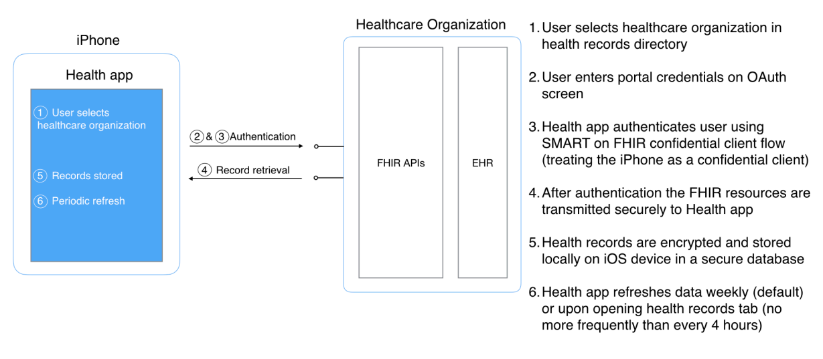
Standard Based API Integration Solution: Overview
Apple has implemented a standards-based API integration solution that follows the Fast Healthcare Interoperability Resources (FHIR) specification from Project Argonaut.
This solution uses a confidential client flow —treating the iPhone as a confidential client—to authenticate Health app users to FHIR APIs from participating healthcare organizations.

Slide 30
FHIR Specification
This technical documentation to guide implementation of Argonaut 1.0.0 compliant “Fast Healthcare Interoperability Resources” (FHIR®, pronounced “fire”) and Substitutable Medical Applications, Reusable Technology (SMART®) on FHIR APIs for healthcare data access. The document has these main sections:
• Authorization: User login, user approval, access and refresh tokens
• Resources: Supported resource types, expected data format, queries, and API calls.
• Flow Overview: Recap in the form of an end-to-end user flow.
Note: Throughout this document, the healthcare organization’s FHIR data server is referred to as the gateway

Slide 31
Authorization

Slide 32
Authorization
The Health app follows the SMART on FHIR protocol in order to receive an access token, which grants access to the user’s health records.
Specifically, the Health app initiates a SMART standalone launch sequence and requests patient context during an OAuth 2.0 Authorization Code Grant flow.
In this authorization flow, the MTBC representative logs in to a web page provided by the health system's authorization server and authorizes the Health app.
1. Access and Refresh Tokens
After successful authorization, the Health app should receive an access token, which should be valid for one hour, and a refresh token, which should be valid for at least one year.
It’s possible to add custom constraints on refresh tokens. For example:
• You can extend the one-year expiration date on a refresh token every time it’s used.
• You can issue a new refresh token upon token refresh.
• You can reject refresh tokens that haven't been used for 90 days as long as their validity period is extended if they are used within 90 days
2. Scopes
The Health app requests access to the MTBC representative information using these scopes:
• Patient/*.read: Give read access to all resources the patient has access to.
• offline_access: Provide a refresh token.
• launch/patient: After login, ask the MTBC representative to select a patient to which to give access (if the user has access to data for more than one patient).
3. Redirect URI
Redirect URI Your server should register the following redirect URIs so that the MTBC representative can be appropriately redirected to the Health app after successful or failed authorization: https://redirect.health.apple.com/HealthProviderLogin/ x-argonaut-app://HealthProviderLogin/

Slide 33
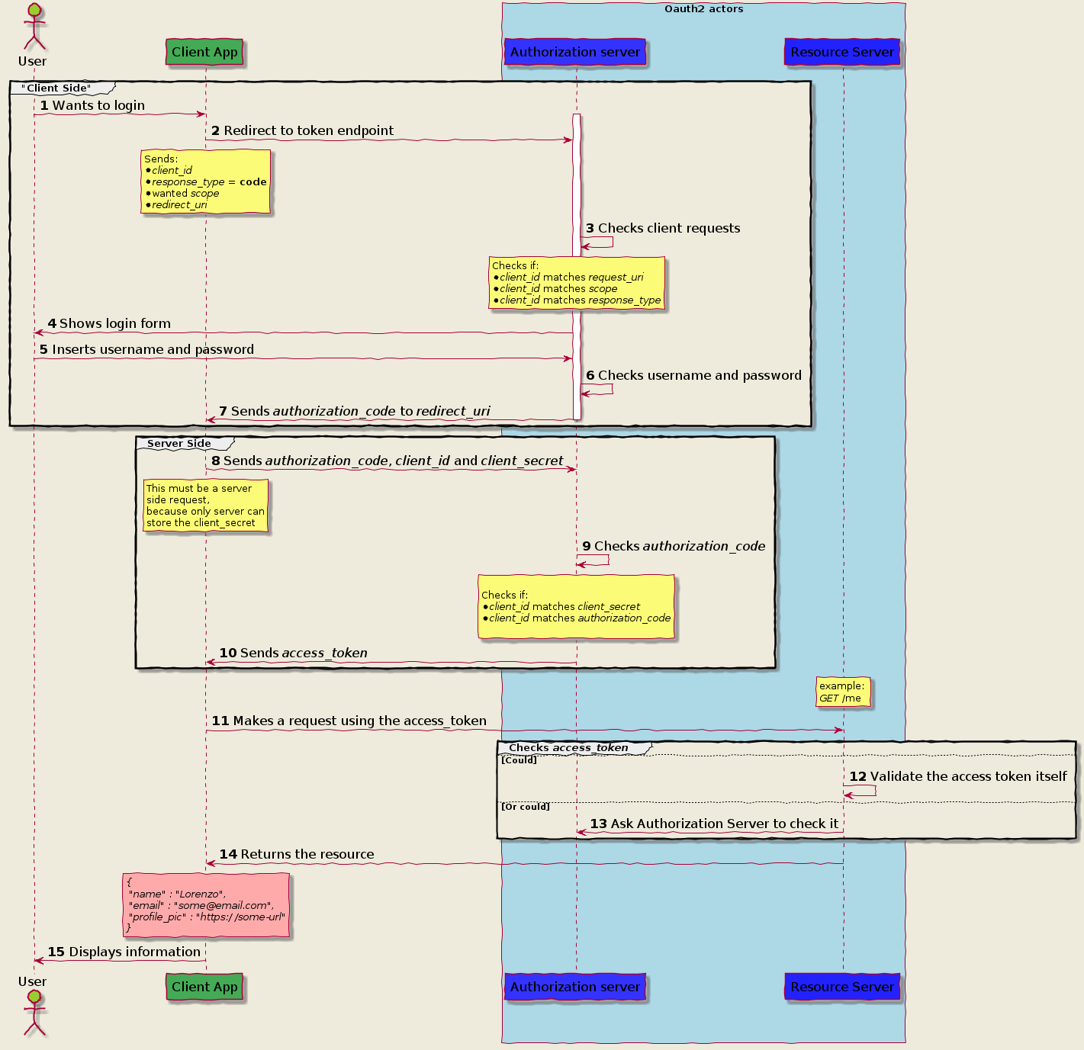
Apple Health App
Apple Health App

Slide 34
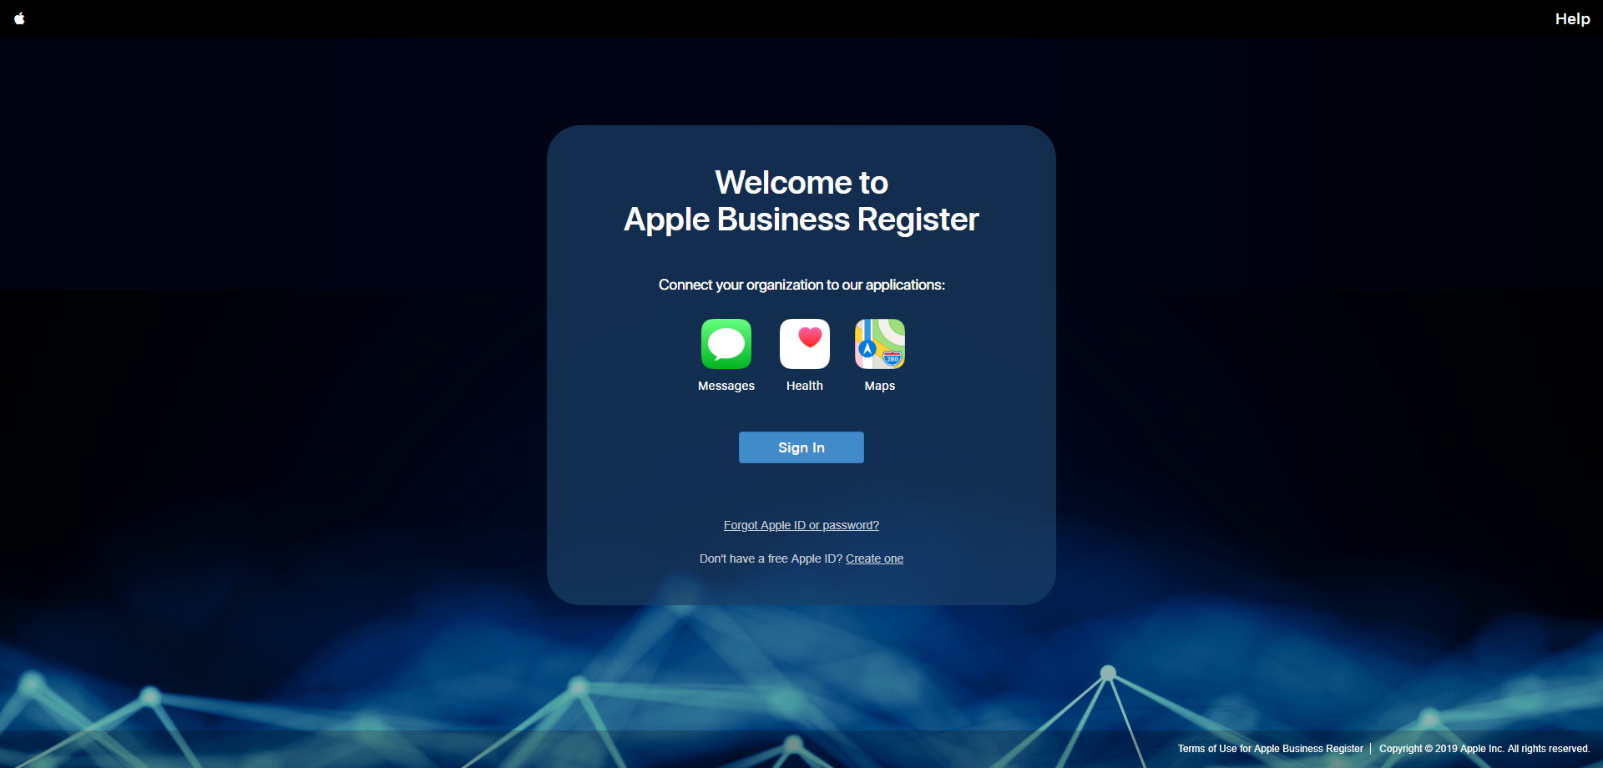
4. Health App Client Registration
In order to register your EHR gateway endpoints, your healthcare organization should first sign up for an account through Apple Business Register (https://register.apple.com/business/ui ) create a business profile.
Once the profile is approved, you can add EHR gateways as additional services, register FHIR endpoints for these gateways, and enter OAuth 2.0 client-id and client-secret information, which will be used by the Health app.
Note: Apple enforces certificate pinning, so you must ensure that all of your FHIR endpoints are TLS/SSL enabled.
MTBC representative need to create an account through Apple Business Register

Slide 35
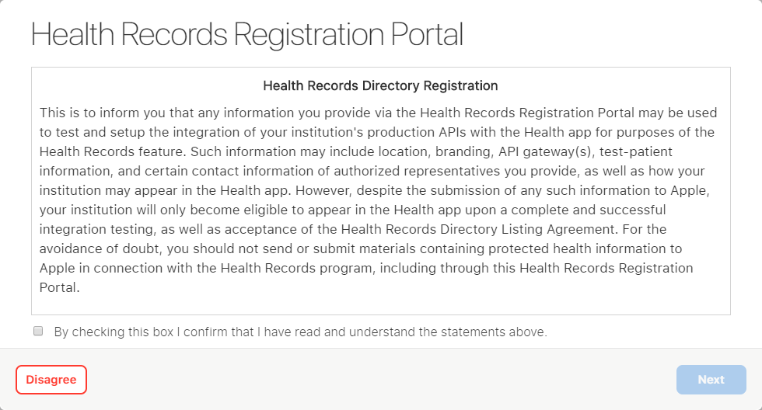
After Registration when MTBC representative sign in Health Record Registration Prompt will open

Slide 36
Signup Document

Slide 37
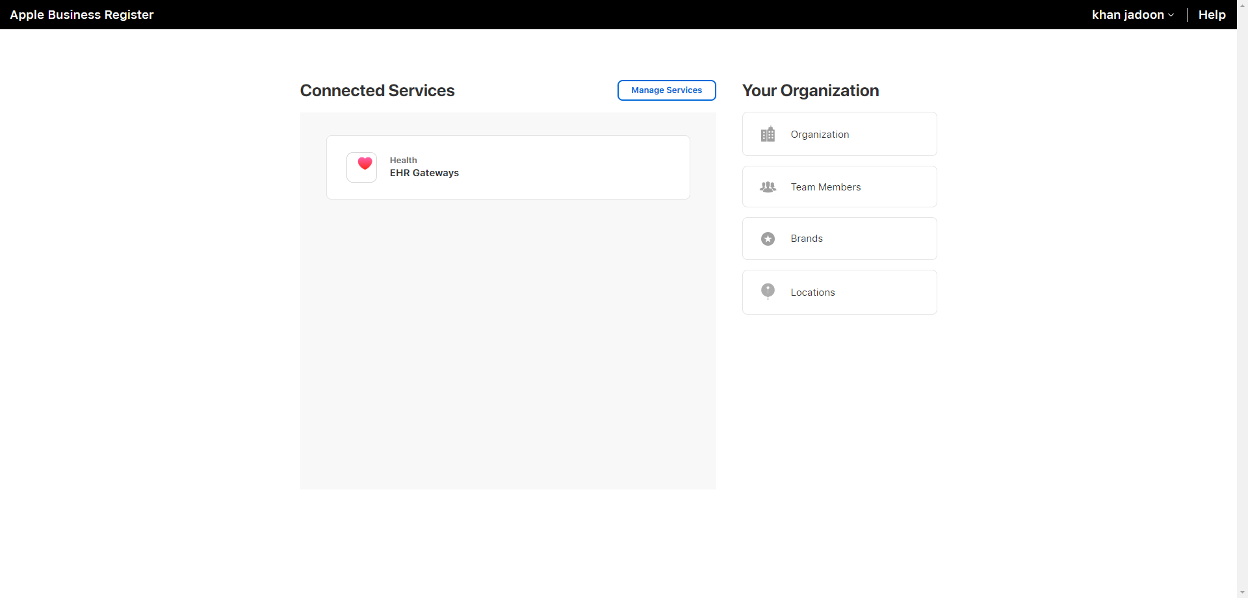
After Clicking Next MTBC representative will redirect to Connected Services Page

Slide 38
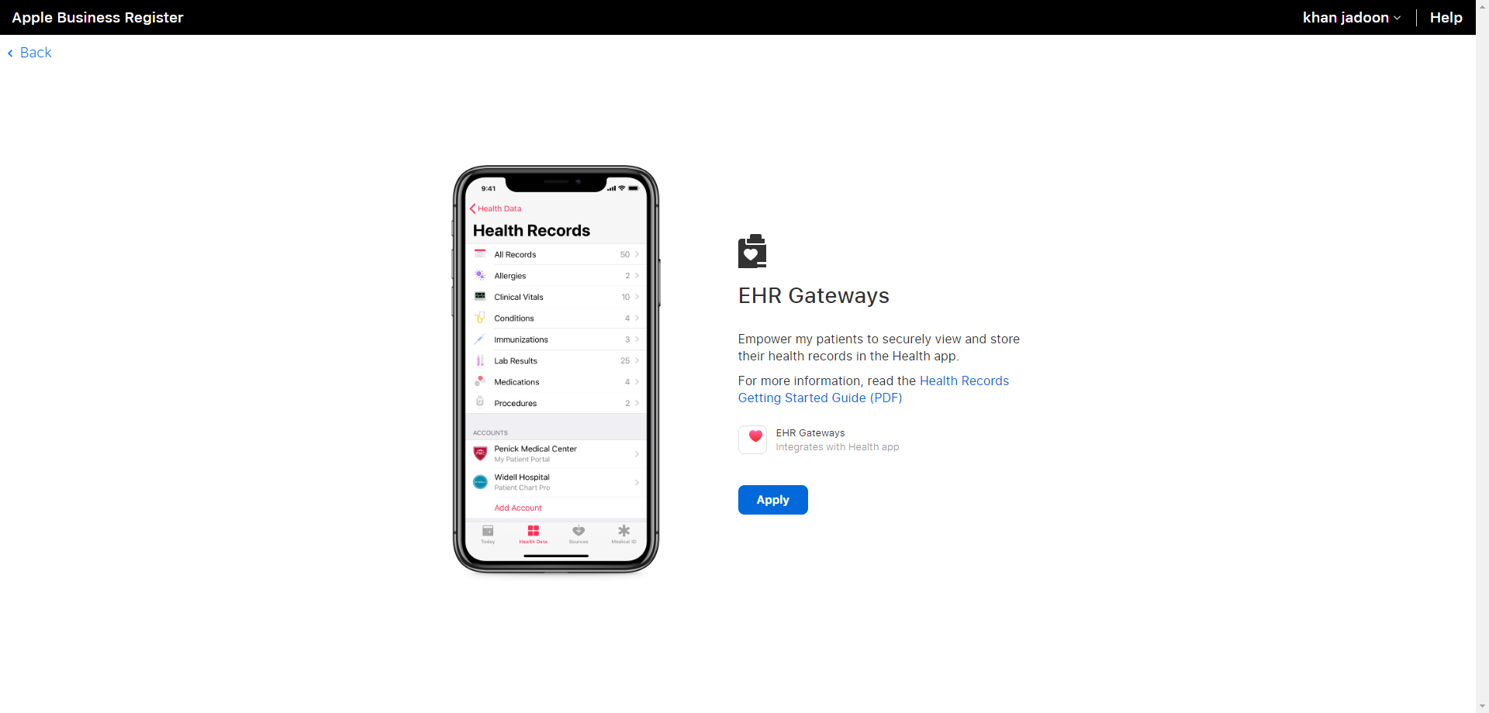
After Clicking Health EHR Gateways MTBC representative will redirect to EHR Gateways Page

Slide 39
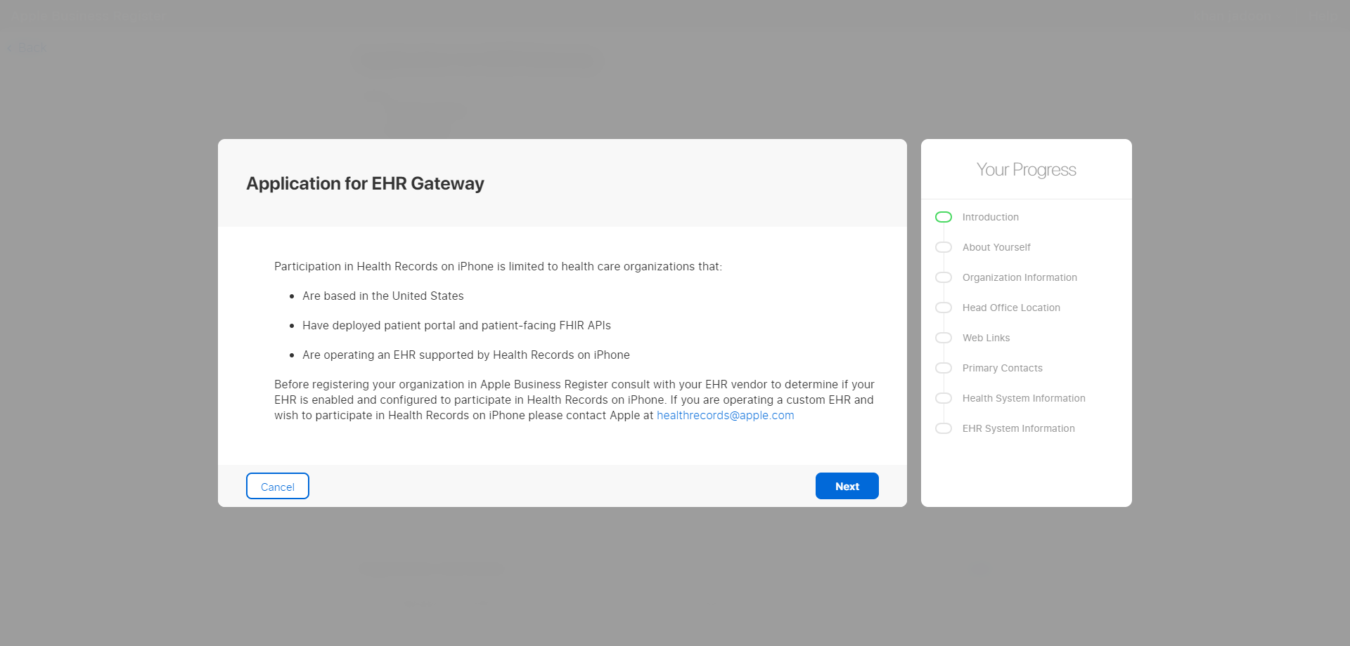
After Clicking Apply MTBC representative will redirect to Application For EHR Gateway Page
MTBC representative need to fill all Information shows in Highlighted area for registering EHR

Slide 40
5. Client Secret Rolling and Overlapping Secrets
Apple needs to be able to roll the client secret in a way that doesn't cause an outage for Health app users.
It’s important to support overlapping secrets for a short period of time and to allow to use refresh tokens to work with a new client secret even if they were created with an old client secret.
6. Authorization Flow: Login
Authorization starts when the healthcare organization's authorization URL is loaded in a Safari View Controller, which prompts the MTBC representative to log in. Apple provides guidance on the design of these login pages in a separate document entitled Health System OAuth Flow Recommendations that you may request from Apple as needed. A fully formed authorization URL will look like this:
https://www.example.com/auth/authorize ?response_type=code ?client_id=D7A38F8C-DC46-4430-8529-A971822EC623 &scope=patient%2F*.read%20launch%2Fpatient%20offline_access &redirect_uri=https%3A%2F%2Fredirect.health.apple.com%2FHealthProvider Login%2F &state=random-string
(line breaks added for clarity. Reference: OAuth 2.0 spec section 4.1.1)
The URL parameters supported for the authorize URL are:
response_type: Always code.
client_id: The client ID assigned to the Apple Health app.
scope: The requested scopes.
redirect_uri: The URI to which the server must redirect the Health app
state: A random string the Health app generates, usually a UUID, that the server needs to return verbatim. The Health app will validate this string after code exchange to help mitigate cross-site request forgery (CSRF) attacks.
Note: Don’t persist logins for the OAuth login window. Each load of the authorization URL should require the MTBC representative to enter their username and password. Apple can supply additional URL parameters to help you enforce reauthorization. It’s recommended that you use prompt=login , which is specified by OpenID Connect section 3.1.2.
Additionally, avoid user-perceivable redirects when loading the authorization URL. The MTBC representative should be able to copy the authorization URL from the login screen, paste it into a browser, and proceed with the login from the browser without losing the OAuth context.

Slide 41
6. Authorization Flow Login (CONT…..)
After logging in, the MTBC representative may be asked to authorize the Health app if this is the first login that uses the Health app. When the MTBC representative grants access, the OAuth 2.0 redirect URI is called with a newly generated code and the state parameter, like so:
https://redirect.health.apple.com/HealthProviderLogin/?state={stateparameter}&code={authorization-code}
(reference: OAuth 2.0 spec section 4.1.2)
7. Login Errors
If there are unrecoverable login errors, such as too many failed login attempts or invalid client-secret, the authorization server may call the callback URI with an error key and supply one of the standardized error values specified in the OAuth 2.0 spec section 4.1.2.1.
8. Authorization Flow: Code Exchange
After authorization, the Health app exchanges the authorization code for an access token by issuing a POST request to the token URL (such as https://www.example.com/auth/ token) with the following headers and body data:
Headers
Authorization: Basic base64(client-id:client-secret)
Content-Type: application/x-www-form-urlencoded
Accept: application/json
The Health app forms a string by concatenating client-id and client-secret with a colon separator, then base-64 encodes the string as defined by HTTP Basic authentication.
The Health app can provide client-id and client-secret in the request body if the authorization server is unable to process the HTTP Basic authentication header.

Slide 42
Body
grant_type=authorization_code&code={authorization-code}
&redirect_uri=https%3A%2F%2Fredirect.health.apple.com%2FHealthProvider Login%2F
(reference: OAuth 2.0 spec section 4.1.3)
Response
{
"access_token": "{access-token}",
"refresh_token": "{refresh-token}",
"expires_in": 3600, // number: seconds the token is valid
"token_type": "bearer",
"scope": "Patient/*.read launch/patient offline_access",
"state": "{state-parameter supplied in authorize URL}",
"patient": "patient id string",
(additional keys are allowed)
}
(reference: OAuth 2.0 spec section 5.1)
9. Refreshing Access Tokens
When the current access token expires, the refresh token obtains a new access token by issuing a POST request to the token URL (such as https://www.example.com/auth/ token) with the following headers and body data:

Slide 43
Headers
Authorization: Basic base64(client-id:client-secret)
Content-Type: application/x-www-form-urlencoded
Accept: application/json
The Health app forms a string by concatenating client-id and client-secret with a colon separator, then base-64 encodes the string as defined by HTTP Basic authentication.
Health app can provide client-id and client-secret in the request body if the authorization server is unable to process the HTTP Basic authentication header.
Body
grant_type=refresh_token&refresh_token={refresh-token}
(reference: OAuth 2.0 spec section 6).
10. Authorization Errors
The authorization server must convey errors with an appropriate HTTP status code for the response as well as a JSON message in the following format:
{
"error": "{error-code}",
"state": "{state-parameter}",
"error_description": "{human readable text}" // optional
}
For reference and a list of valid error codes see: OAuth2 spec section 5.2

Slide 44
Resources

Slide 45
Resources
The Health app supports the following FHIR resources. It will perform a search interaction on all supported resource types except Medication, meaning the Health app will append patient=123 (and _id=123 in the case of Patient) to find resources pertaining to the patient. Note that the Health app does not currently support reference-style query parameters, such as subject=Patient/123.
The Health app supports these FHIR resources:
FHIR Resources | Reference | Reference
AllergyIntolerance | [FHIR] | [Argonaut]
Condition | [FHIR] | [Argonaut]
DiagnosticReport | [FHIR] | [Argonaut]
Immunization | [FHIR] | [Argonaut]
Medication | [FHIR] | [Argonaut]
MedicationDispense | [FHIR] | [Note ↓]
MedicationOrder | [FHIR] | [Argonaut]
MedicationStatement | [FHIR] | [Argonaut]
Observation | [FHIR] | [Argo:labs, Argo:vital-signs]
Patient | [FHIR] | [Argonaut]
Procedure | [FHIR] | [Argonaut]
Referenced Resources
FHIR makes extensive use of references; however, only a few are of immediate interest in the current version of the Health app. The Health App will perform a read interaction in an attempt to retrieve the referenced resource for the references called out below.
Language
Resources that have non-English content (except in their narrative) or originate from outside the US must populate the language property. An IETF language tag consisting of both a language code and a region code (such as en-US or fr-CA) must be used, according to Resource.language

Slide 46
Resource Details
Condition
Your gateway should not expose billing information through Condition resources. If necessary, the Health app may query only for conditions with the categories diagnosis and problem:
Condition?patient={id}&category=diagnosis,problem
Avoid applying a default filtering to Condition resources, like only returning active conditions. If necessary, the Health app may query for active as well as resolved conditions like so:
Condition?patient={id}&clinicalstatus=active, resolved
DiagnosticReport
At this time Apple is only interested in DiagnosticReport resources that represent a lab panel, meaning a DiagnosticReport resource should be linked (contained or referenced) to one or more Observation resources in its result array. If Observation resources are relative or absolute references, the Health App will attempt to retrieve them with a read operation.
Reports without results will be ignored.
MedicationDispense
MedicationDispense is not part of Argonaut 1.0, but its implementation is welcome, if available, with these constraints:
• One status in MedicationDispense.status
• One date in MedicationDispense.whenHandedOver
• One patient reference in MedicationDispense.patient
• One medication through MedicationDispense.medicationCodeableConcept or MedicationDispense.medicationReference with at least one coding in Medication Clinical Drug (RxNorm).

Slide 47
MedicationDispense (Contd…)
• One MedicationDispense.authorizingPrescription referencing the respective MedicationOrder, where available
If the resource provides a medicationReference reference, the Health App will attempt to retrieve the referenced Medication with a read operation.
MedicationOrder / MedicationStatement
If the resource provides a medicationReference reference, the Health App will attempt to retrieve the referenced Medication with a read operation.
Observation
Under Argonaut, only Observation resources with categories of laboratory, vital-signs and smoking status (usually with a category of social-history) are expected. Apple is currently only interested in the former two categories, hence the Health app will issue this request for Observation resources:
Observation?patient={id}&category=vital-signs,laboratory
Note that Observation resources must either have a value (any of the value[x] fields filled) or dataAbsentReason. For numeric values, valueQuantity is preferred. The Health app does not currently support Observation resources that act as a lab panel and that link panel components via the related property.
Also, use Observation.component for blood pressure measurements, as opposed to individual related resources.
If possible, populate Observation.referenceRange with Quantity values, which allows the Health app to indicate out-of-range values. In addition, if possible, populate Observation.interpretation with a coded value, especially for abnormal results.
Patient
The Patient resource should have at least a given name, a family name, a gender, and a birth date.

Slide 48
Procedure
Following the recommendations on Procedure, it is recommended that the generation of Observations and DiagnosticReports do not result in the creation of a Procedure resource. For example, the act of taking a blood pressure reading need not be documented in a Procedure resource, because the Health app is receiving the actual blood pressure as an Observation already.
FHIR Format Guidelines
• The Health app’s FHIR implementation uses the FHIR DSTU-2 (FHIR version 1.0.2) API and data model specifications. When in doubt, refer to the FHIR spec.
• Provide FHIR data in JSON format. The Health app will issue an Accept header on requests with a value of application/json+fhir. The Health app may issue application/json if the FHIR specific header causes issues on the EHR gateway.
• Strings in FHIR are case-sensitive. All resource names require an uppercase first letter everywhere they appear, even in URLs. It’s okay to accept lowercase versions in URLs, but the canonical, first-letter-uppercased form MUST be supported.
• Consult the official FHIR documentation to get answers to specific format questions, as well as the Argonaut spec, especially on these matters:
• Determine which properties on each resource are required to be included and which are optional.
• Make sure you use one of the valid strings for code type properties.
• Null values as well as empty arrays and objects should not be present, the property should be omitted in such cases.
• FHIR considers any string with letters, numbers, dashes and periods, up to a length of 64 characters, as a valid id. The Health app uses the patient ID as the authorization server returns it during Authorization Flow: Code Exchange. It doesn’t matter whether the ID is an encrypted or hashed version of an internal ID or an actual ID, as long as it adheres to the format.
• id and identifier are two different properties in FHIR. Patient search is executed against the patient id property
• all resources, not just Patient, must have an id

Slide 49
FHIR Format Guidelines (Contd…)
• Adhere to all FHIR formats, especially the date/time formats:
• There must be a timezone whenever a time is present. Use the timezone local to the original event in order to avoid confusion.
• Avoid adding 00:00:00 time if only the date is known – only return a date in such cases.
• The Health app enforces correct timing for Period elements, for example, start must be earlier than or equal to end.
• Avoid stripping comments and notes from resources.
• Consider supporting the _lastUpdated query parameter, especially on Observation resources. This will enable more efficient updates that will conserve your server resources.
• Also consider populating the meta.lastUpdated property for every resource so the MTBC representative may know more accurately when the record was last changed.
• Consider supporting the _include query parameter, especially on DiagnosticReport resources.
REST Operation
From the possible FHIR REST API operations (called interactions) the Health app uses two, read and search:
Read
A FHIR read interaction is a GET request for a single resource known by its id.
(reference: FHIR Spec)
Examples:
GET https://www.example.com/fhir/Patient/GH42VTX
GET https://www.example.com/fhir/MedicationOrder/MR82ESC

Slide 50
Read (Contd)
The response to a read is the requested resource directly. See Supported Resources for a list of resource types the Health app currently supports and their format. Example Patient resource:
{
"resourceType": "Patient",
"id": "GH42VTX",
"name": [
{
"family": [
"Doe"
],
"given": [
"Jeanine"
],
"use": "official“
}
],
"birthDate": "1976-04-01",
"gender": "female",
(more Patient data as available)
…
}
Search
A FHIR search interaction is a GET request returning a Bundle resource containing search results.
(reference: FHIR Spec)
Examples:
GET https://www.example.com/fhir/Patient?_id=GH42VTX
GET https://www.example.com/fhir/MedicationOrder?patient=GH42VTX

Slide 51
Search Contd
The response here is always a Bundle resource that contains the search results, for example:
{
"resourceType": "Bundle",
"type": "searchset",
"total": 1, // optional
"entry": [
{
"fullUrl": "https://www.example.com/fhir/Patient/GH42VTX",
"resource": {
"resourceType": "Patient",
"id": "H99GBHGAH",
"name": […],
(remaining Patient content)
},
"search": { // optional
"mode": "match"
}
},
{
(more entries)
},
…
],
"link": [
{
"relation": "self", // optional, link to this search result
"url": "https://www.example.com/fhir/Patient?_id=GH42VTX"
},

Slide 52
Search (Contd)
{
"relation": "next", // next page of search results, if any
"url": "https://www.example.com/fhir/Patient?_id=GH42VTX&page=2"
}
]
}
On search the server must not apply default filtering in the absence of query parameters. For example, unless a specific status is specified, a search must return resources of all statuses.
The server may limit the number of resources returned per Bundle. Paging is accomplished when the server provides a link to the next page of search results in the link object with a relation of next. The Health app will keep following links to the next page until there are none left. The default size for a Bundle is 50 resources
Conformance
The conformance interaction is used to return the Conformance statement. This resource should be available at the /metadata endpoint (that is, https://www.example.com/fhir/ metadata), should list the FHIR server's capabilities and, as an extension, list the authorization URLs according to the SMART specification.
Coding Systems
For coded values, use the coding systems that Argonaut mandates. If this isn’t possible, return the data coded in the system available to you (like ICD-10 for procedures if it's not possible to return SNOMED-CT codes). Ideally the display property of the coding elements contains the respective preferred name of the coding system. The top level text element of CodeableConcept elements should be a string that presents clearly to MTBC representative, for example:

Slide 53
Coding Systems Contd
"code": {
"coding": [
{
"code": "8636-3",
"display": "Q-T interval corrected",
"system": http://loinc.org
}
],
"text": "QT Interval"
}
For units on quantities always prefer UCUM unit codes.
Request Errors
If errors occur during FHIR requests:
• Respond with appropriate HTTP status codes in the 400 and 500 range.
• If an authorization error occurs (no access token or expired/invalid access token), return a 401 header and a WWW- Authenticate header.
• Return an OperationOutcome in JSON format in the response body

Slide 54
App Flow

Slide 55
App Flow
This section describes what happens in the Health app once your gateway is registered and enabled. It walks through system validation step by step.
Replace the www.example.com sample URLs with your own endpoint URLs.
1. Open authorization page in browser view
• The Health app opens https://www.example.com/auth/authorize? response_type=code&... in a browser. See Authorization Flow: Login for details.
• The MTBC representative enters credentials and logs in.
• If the MTBC representative has access to more than two patients, a list of available patients is shown and the user selects one, like mother and child.
• The MTBC representative authorizes the Health app to access data from the selected healthcare organization.
• OAuth 2.0 redirect URI is called with the code and state parameters.
2. Health app uses code against token endpoint to retrieve tokens and patient id
• The Health app issues a POST request with a www-form-encoded payload to https:// www.example.com/auth/token, with at least these headers:
• Authorize: Basic {client-id:client-secret in base64}
• Accept: application/json
• The authorization server returns a JSON response containing access token, refresh token, and the patient ID.
3. Use access token to search for patient demographics
• The Health app issues a GET request to https://www.example.com/fhir/Patient? _id={patient ID} with these headers:
• Authorize: Bearer {access token string}
• Accept: application/json+fhir
• Response: FHIR Bundle resource with one Patient entry
• If there’s no access token, or an expired or invalid access token: HTTP status code 401 and WWW-Authenticate header, ideally with OperationOutcome resource body
• If the patient ID is wrong: HTTP status code 403, ideally with OperationOutcome resource.

Slide 56
4. Use access token to search for patient data
Repeat the patient data search for all resource types that the gateway supports:
• Issue GET request to https://www.example.com/fhir/MedicationOrder? patient={patient ID} with these headers:
• Authorize: Bearer {access token string}
• Accept: application/json+fhir
• Response: FHIR Bundle resource with resulting resources in JSON and Bundle.type set to searchset.
• If there’s no access token, or an expired or invalid access token: HTTP status code 401 and WWW-Authenticate header, ideally with OperationOutcome resource body.
• If the patient ID is wrong: HTTP status code 403, ideally with OperationOutcome resource.
5. Use access token to read individual/referenced resources
• Issue GET request to https://www.example.com/fhir/Medication/{resource ID} with at least these headers:
• Authorize: Bearer {access token string}
• Accept: application/json+fhir
• Repeat for other resource types as needed.
• Response: FHIR resource in JSON.
• If there’s no access token, or an expired or invalid access token: HTTP status code 401 and WWW-Authenticate header, ideally with OperationOutcome resource body.
• If no access to the requested resource: HTTP status code 403, ideally with OperationOutcome resource.
6. Use refresh token to retrieve new access token
If the current access token has expired and the Health app is querying for new data:
• The Health app issues a POST request with www-form-encoded payload to https:// www.example.com/auth/token, with at least these headers:
• Authorize: Basic {client-id:client-secret in base64}
• Accept: application/json
• The authorization server returns a JSON response containing an access token, and optionally a new refresh token and the patient ID.

Slide 57
General Recommendations

Slide 58
General Recommendations
Overall OAuth 2.0 flow
Employ a mobile-first responsive design for the entire OAuth 2.0 flow, including:
• A simple, uncluttered layout.
• Tap targets large enough for fingers (not mouse cursors).
• Font sizes appropriate for 4” phones.
• Use of your health system branding and colors. Remember to avoid color combinations that are not accessible to color blind users, for example, green and brown or blue and grey.
• No large images or logos that result in unnecessary scrolling. Tall content may result in the login button being hidden.
• Only one primary action per step, with a secondary call as needed. Avoid requiring multiple button taps to proceed to the next step, including menus that need to be “unfolded” to reveal additional content.
Login page
• For users who haven't yet signed-up for a patient portal account, use this as an opportunity to help them sign up by including a button to create an account.
• Include basic troubleshooting mechanisms like “forgot username/password” links, a help page link, and contact information.
• Avoid displaying information about other health system services that could cause the OAuth flow to become confusing, for example, pop-ups or pop-overs describing additional functionality.
Authorization page
• Minimize detailed legal text as this often causes confusion and users don't read it. Here is some suggested text that should be reviewed by your legal and marketing departments:
o This app was not created by your healthcare organization. Approving this request allows this app access to your personal health information with different privacy policies than your healthcare provider. Please review their terms of service and privacy policy.
• Avoid displaying large images that could cause the authorization page to become confusing (for example, trademarked logos like the FHIR logo).

Slide 59
General Recommendations
Page loading and navigation
• Ensure that the page loads quickly (less than 1 second) by avoiding large images or files, such as a detailed background image.
• Test the page on iOS devices within Mobile Safari or within the MacOS Safari Responsive Design Mode.
• Don't use redirects to native mobile apps like a patient portal app. Introducing custom URL scheme redirects can break the OAuth flow.
Branding
• Use an Extended Validation (EV) Certificate that includes the EHR or health institution brand name. This adds credibility and makes a positive impression.
Example: Extended Validation Certificate
MTBC, Inc.
Secure Connection
Your are securely connected to this site, owned by:
MTBC, Inc.
Somerset NJ, US
Verified by: Go Daddy Secure Certificate Authority - G2
More Information

Slide 60
Impact Analysis
Integrating health data from Apple watch to talkEHR.

Slide 61
Checklist
Points |  | Yes / No / NA
1 | Requirements are complete and finalized | Yes
2 | Requestor's sign off on requirements
3 | Analyzed requirements and system needs to be changed | Yes
4 | Analyzed current functionality completely | Yes
5 | Field validations are included for all fields(buttons, text boxes, drop down lists etc) | NA
6 | Text of the prompts are verified by Lo’ / marketing team | NA
7 | DB level changes are included in the storyboard | NA
8 | Scope of the change is defined | Yes
9 | Impact analysis is included in the document | Yes
10 | Storyboard is signed off by SA Team Lead and SA Team Manager
11 | Requestor's sign off on proposed changes
12 | Storyboard is technically Signed off by Development Team Lead
13 | Comments:

Slide 62

Thank you

